Slide 1
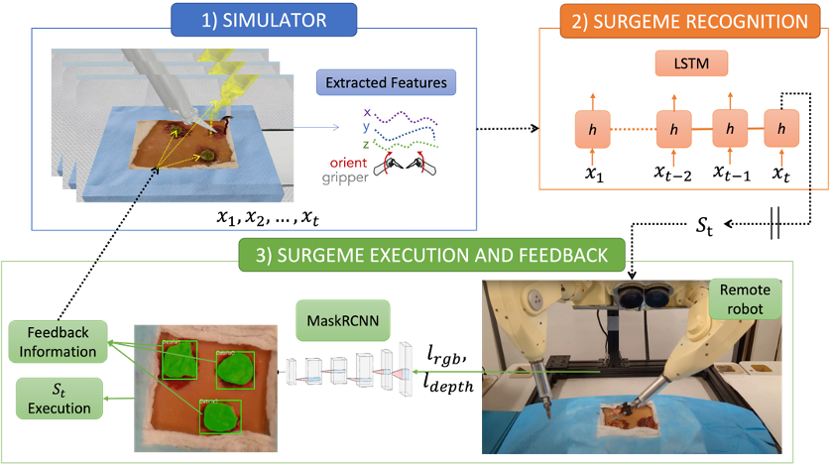
A FUNDAMENTAL THEORY FOR DEXTEROUS SURGICAL SKILL TRANSFER TO ROBOTS

Slide 2
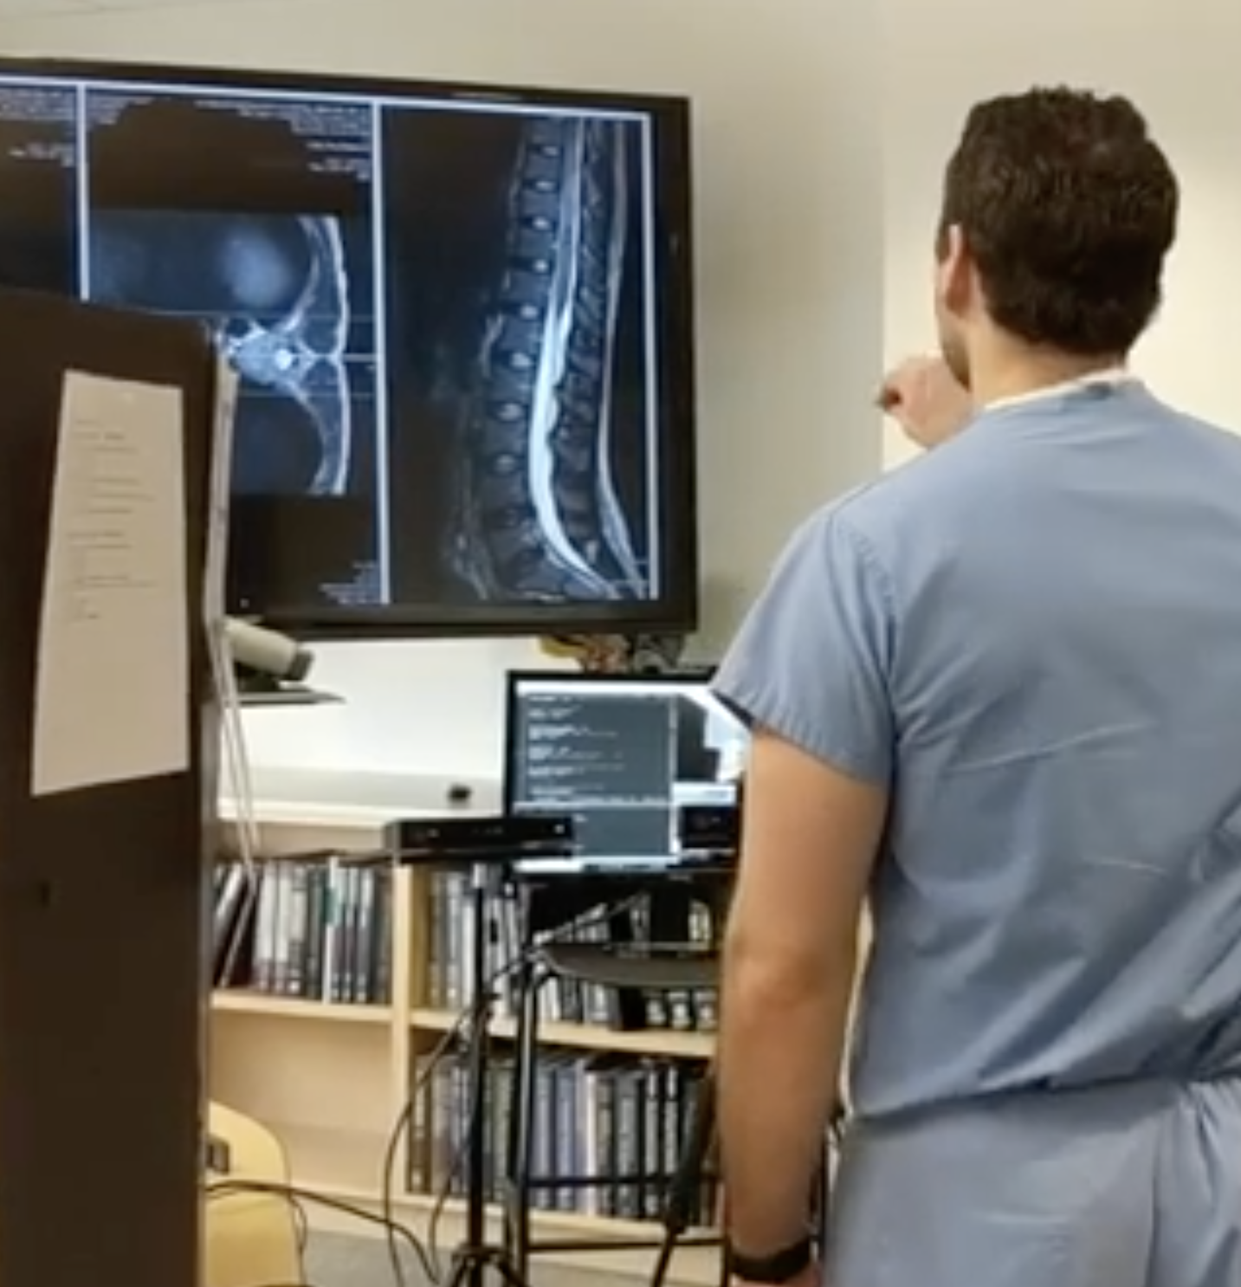
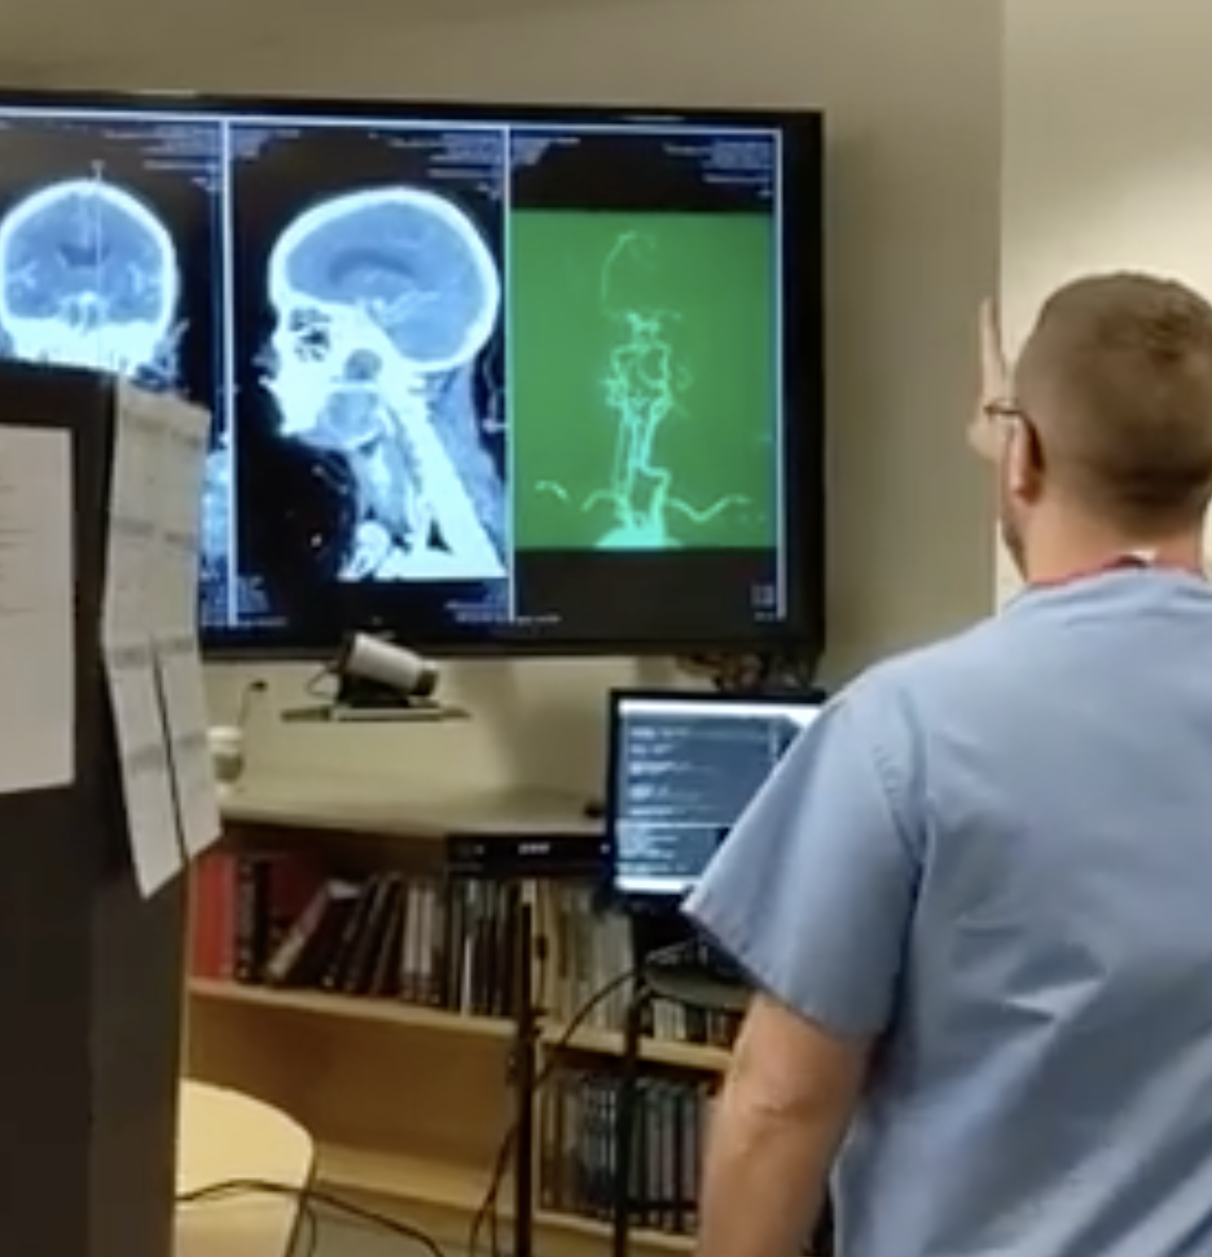
A TOUCHLESS INTERACTION LANGUAGE FOR THE OR

Slide 3
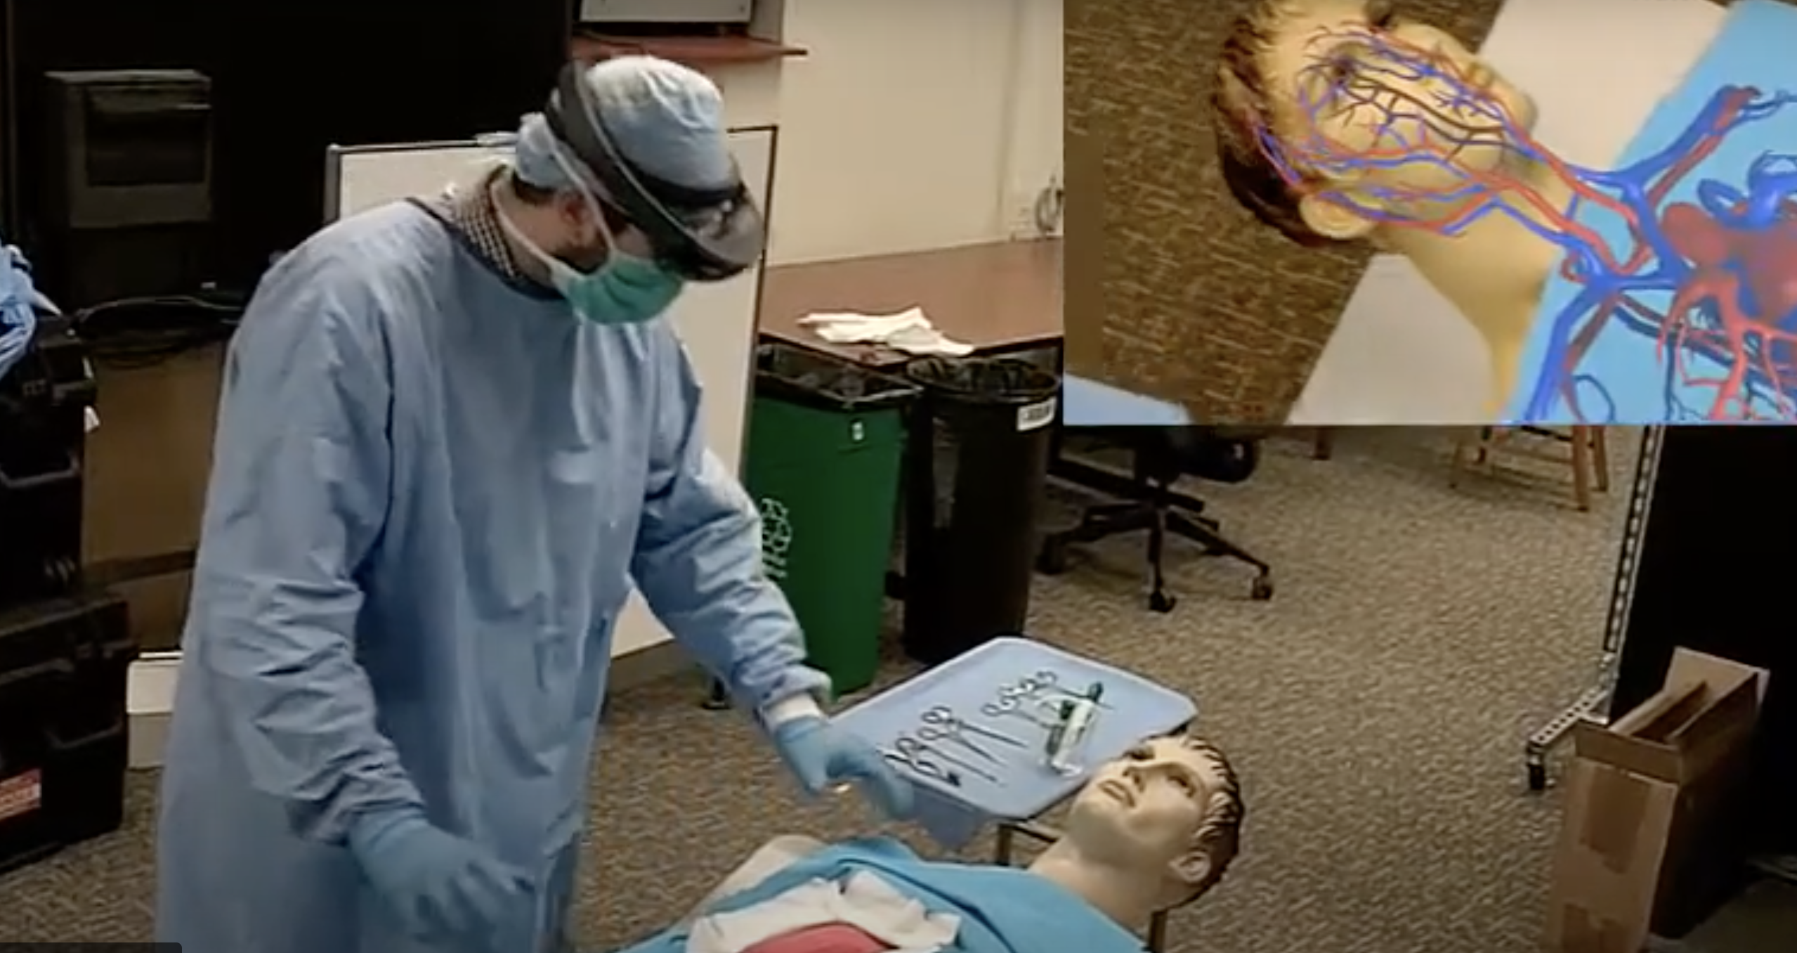
STAR: SYSTEM for TELEMENTORING with AUGMENTED REALITY

Slide 4
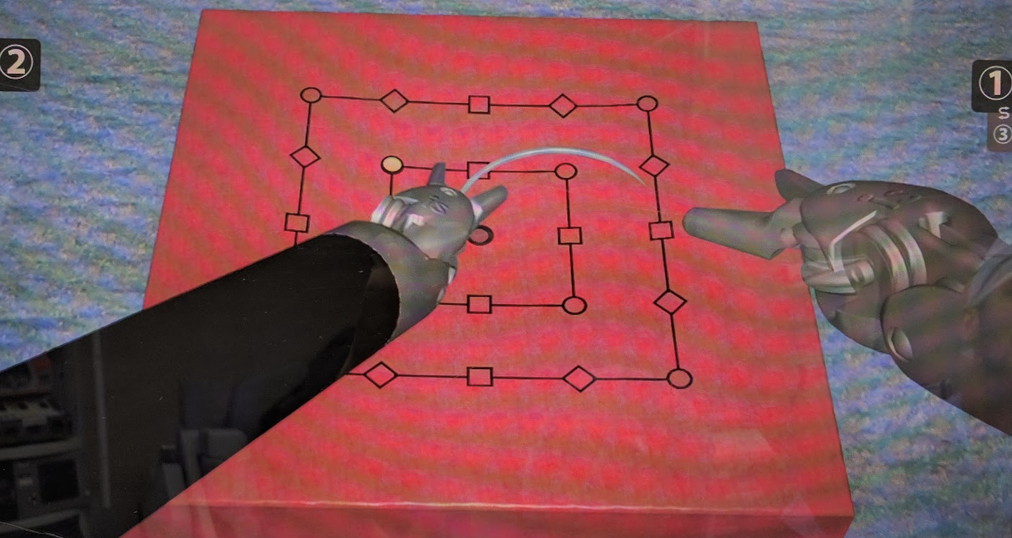
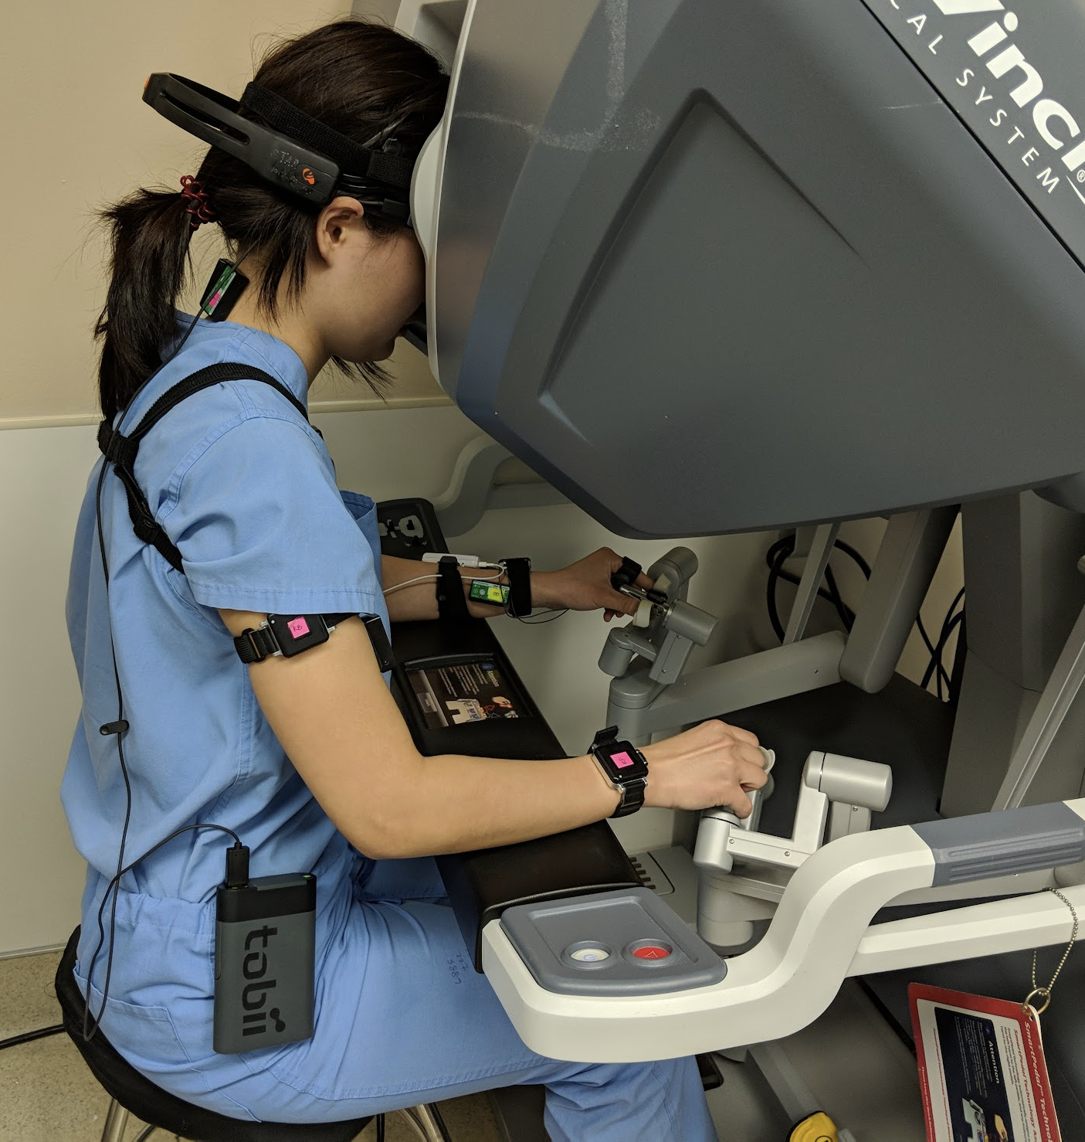
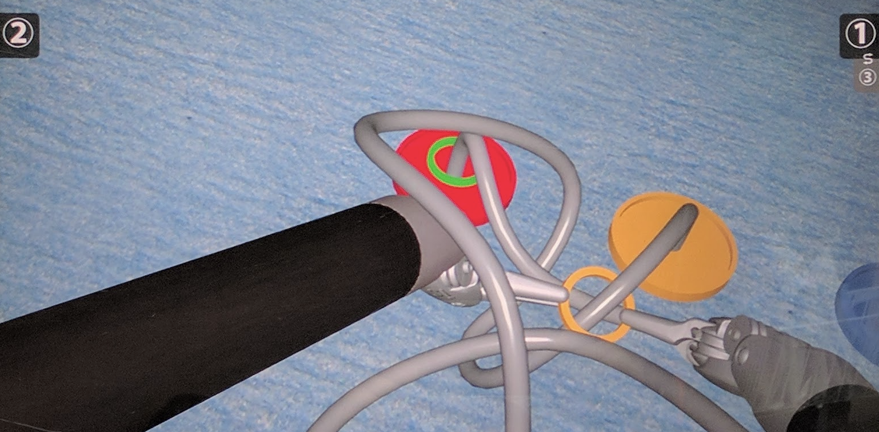
Workload Assessment during robotic surgery

